Slide 1

Logistic Regression

Slide 2
Background
So far we’ve only seen regression problems where we try to predict a continuous value.
Although the name may be confusing at first, logistic regression allows us to solve classification problems, where we are trying to predict discrete categories.
The convention for binary classification is to have two
classes 0 and 1.

Slide 3
Types of Logistic Regression
1. Binary Logistic Regression
The categorical response has only two 2 possible outcomes. Example: Spam or Not
2. Multinomial Logistic Regression
Three or more categories without ordering. Example: Predicting which food is preferred more (Veg, Non-Veg, Vegan)
3. Ordinal Logistic Regression
Three or more categories with ordering. Example: Movie rating from 1 to 5

Slide 4
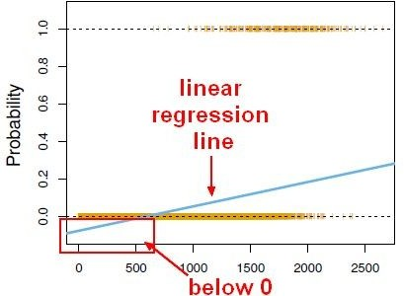
Background
We can’t use a normal linear regression model on binary groups. It won’t lead to a good fit:

Slide 5
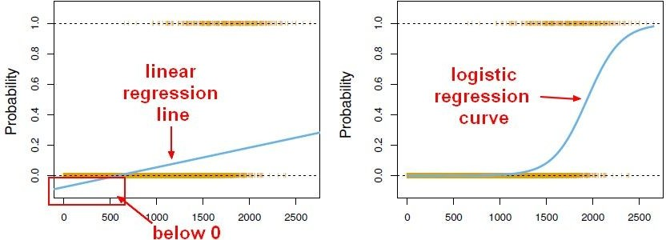
Background
Instead we can transform our linear regression to a logistic regression curve.

Slide 6
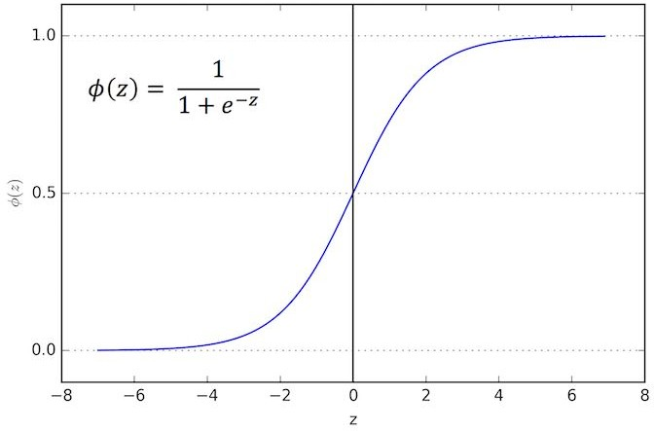
Sigmoid Function
The Sigmoid (aka Logistic) Function takes in any value and outputs it to be between 0 and 1.

Slide 7
Sigmoid Function
This means we can take our Linear Regression Solution and place it into the Sigmoid Function.

Slide 8
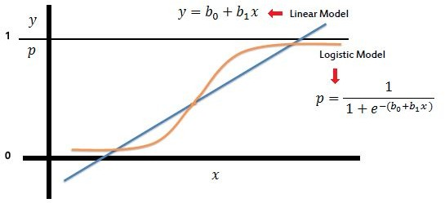
Sigmoid Function
This means we can take our Linear Regression Solution and place it into the Sigmoid Function.

Slide 9
Sigmoid Function
This results in a probability from 0 to 1 of belonging in the 1 class.

Slide 10
Sigmoid Function
We can set a cutoff point at 0.5, anything below it results in class 0, anything above is class 1.

Slide 11
Review
We use the logistic function to output a value ranging from 0 to 1. Based off of this probability we assign a class.

Slide 12
Model Evaluation
After you train a logistic regression model on some training data, you will evaluate your model’s performance on some test data.
You can use a confusion matrix to evaluate classification models.

Slide 13
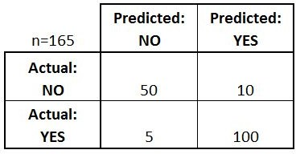
Model Evaluation
We can use a confusion matrix to evaluate our model.
For example, imagine testing for disease.
Example: Test for presence of disease NO = negative test = False = 0
YES = positive test = True = 1

Slide 14
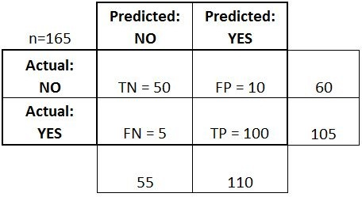
Confusion Matrix
Basic Terminology:
True Positives (TP)
True Negatives (TN)
False Positives (FP)
False Negatives (FN)

Slide 15
Confusion Matrix
Accuracy:
Overall, how often is it
correct?
(TP + TN) / total = 150/165 = 0.91

Slide 16
Confusion Matrix
Misclassification Rate (Error Rate):
Overall, how often is it
wrong?
(FP + FN) / total = 15/165 = 0.09

Slide 17
Optional Reading
Sections 4-4.3 of
Introduction to Statistical Learning
By Gareth James, et al.

Slide 18
Reading Tasks
https://towardsdatascience.com/logistic-regression-detailed-overview-46c4da4303bc
https://machinelearningmastery.com/logistic-regression-tutorial-for-machine-learning/
https://www.datacamp.com/community/tutorials/understanding-logistic-regression-python
With Example → https://www.tutorialspoint.com/machine_learning_with_python/classification_algorithms_logistic_regression.htm

